Slide 1
Analysis of Airline customer ratings
By:
Group 9: Srivathsav Mitnala Mradul Mundra

Slide 2
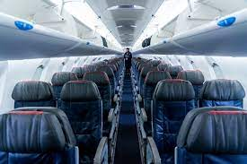


Slide 3
Goal of the project
To predict the outcome of whether a customer travelling through the airline is satisfied or unsatisfied with their trip.
There are several factors that need to be considered in an airline travel experience. We analyzed the main features that play a role in customer satisfaction.
This analysis would be useful for the companies in the airline industry in understanding the areas they should focus on to provide a good experience for their customers

Slide 4
Data Description
The dataset was extracted from Kaggle and it contains 129980 rows and 25 columns.
The variables have numeric, categorical and ordinal types and have been divided into sub-groups:
There are satisfaction ratings for various parameters like online booking, onboard service, inflight Wi-Fi, seat comfort etc.
The ratings of all these columns range from 0-5. Except for the inflight WIFI service rating which has a range from 1-5
It also has other details of the customer like age, gender and type of travel, along with distance travelled on the flight.

Slide 5
Data Pre-processing
There are 25 columns in our original dataset.
Checked for Null values, and only Arrival Delay in Minutes had 393 values, which is less than 1 % of the data, so these records were removed.
We had to label encode some of the variables like, gender, customer type, Type of travel, class before applying the models
Then we normalized some variables like age, flight distance, which were on a different scale to the same scale for Knn
Then we divided our data into training data and test data with 30% of the total data being test data.

Slide 6
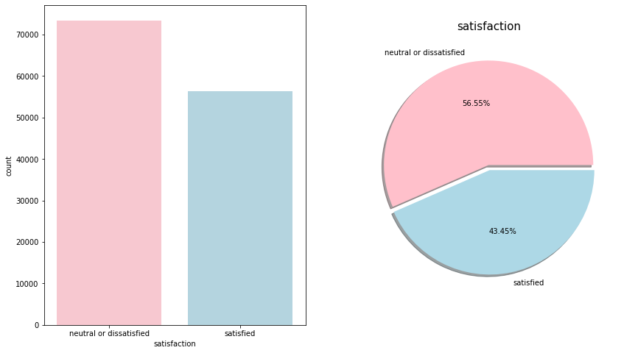
Distribution of Target Variable
It can be seen from the plot here that more number of customers found their trip to be unsatisfactory.
Further analysis was done on this to find out the ratings for different kinds of services provided

Slide 7
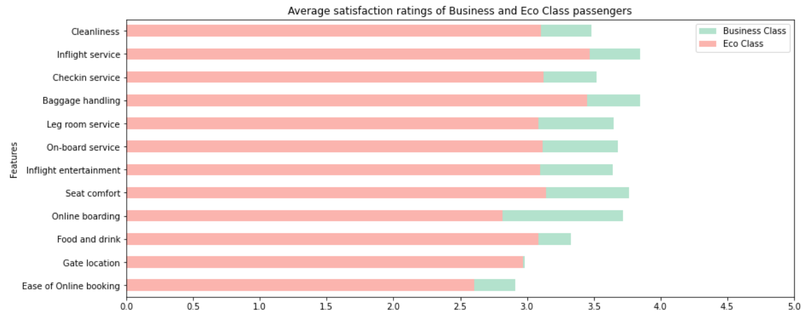
Average ratings distribution for customers travelling on economic class and business class
As it can be observed, none of the services are rated are above 4, which indicates that improvements need to be made, especially for the economy class, where the ratings have been lower.

Slide 8
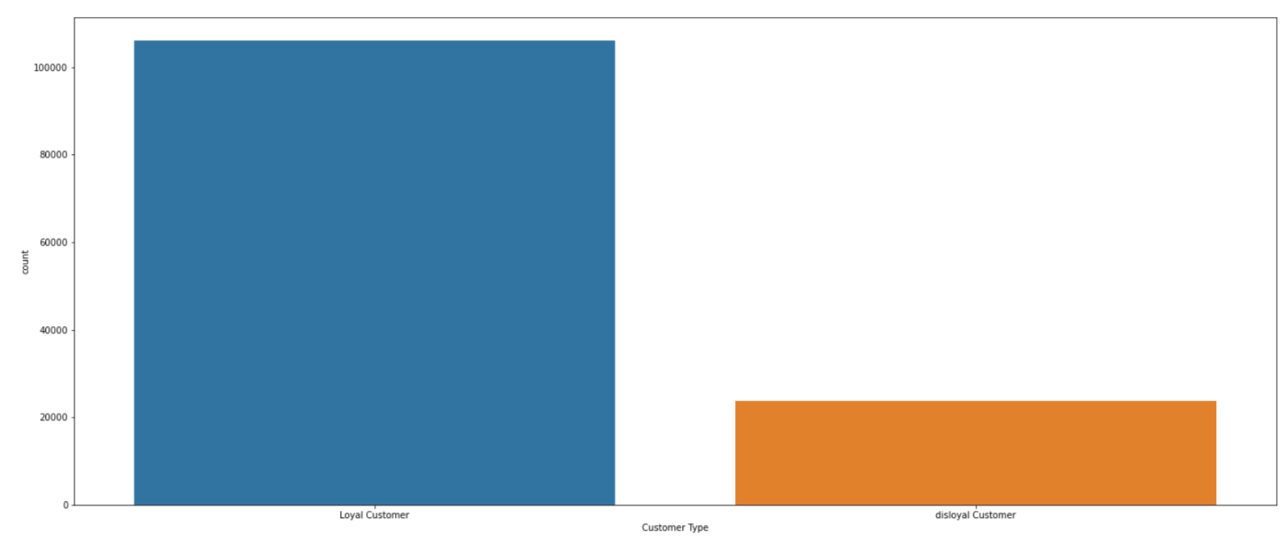
Customer Retention
Customer Retention is another important aspect that will make sure that there is a steady revenue stream, and as can be seen the number of loyal customers is pretty high despite the poor average ratings.

Slide 9
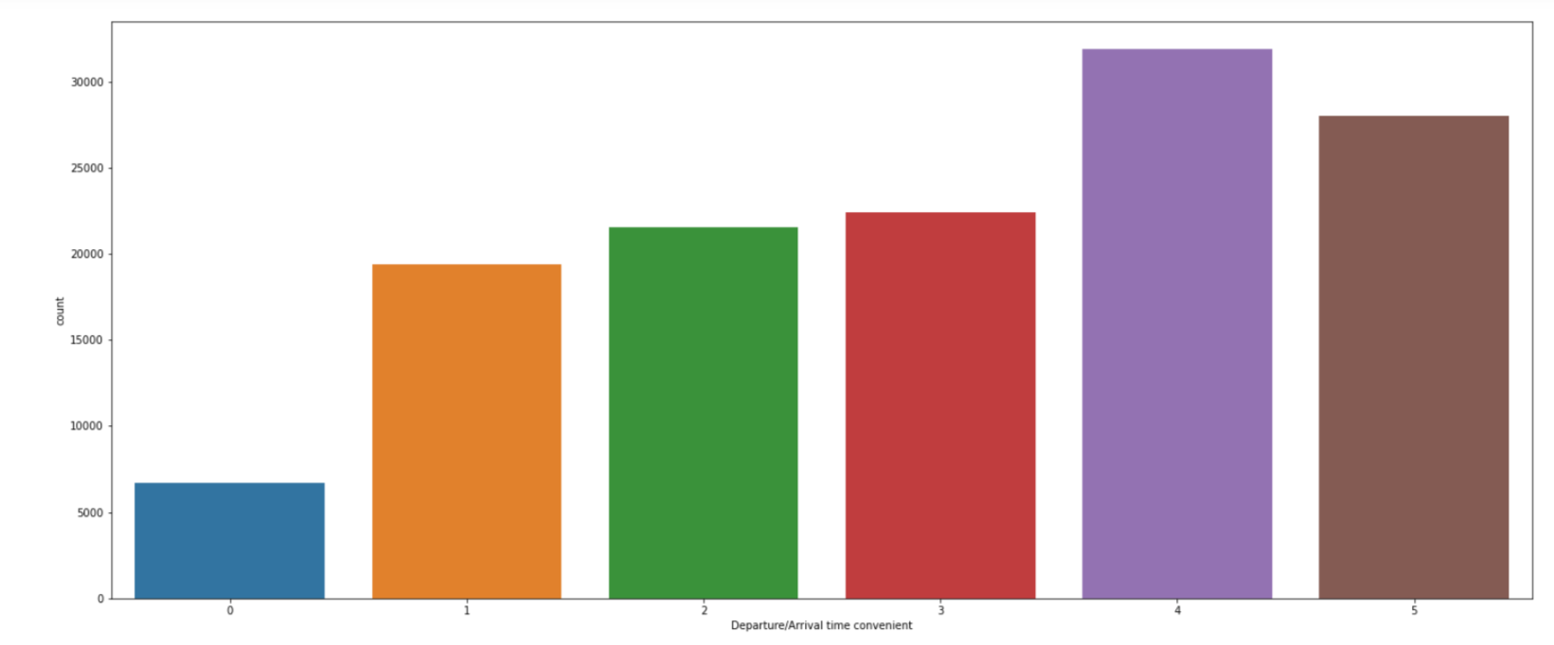
As can be seen above the average ratings in the case of convenience of time delay factor for arrival and departure, it can be observed that more customers found this particular feature to be good and this could be one of the reasons why customers continue to use this airline for travel, because it does not have a lot of delays.

Slide 10
Application of Models

Slide 11
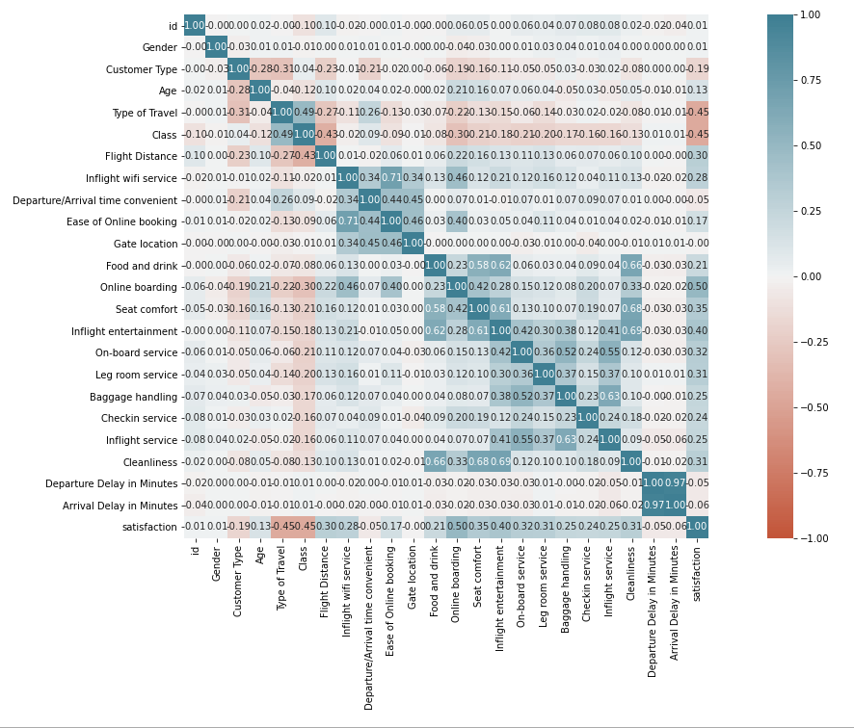
Feature selection for prediction
Considered variables that have a correlation greater than 0.3 with the target variable.
Because the maximum correlation that exists is 0.5, picking the range of 0.3-0.5 for getting the predictions and fitting the model is ideal

Slide 12
Classification Models used
K Nearest Neighbours
Logistic Regression
Support Vector Classifier
Random forest Classifier

Slide 13


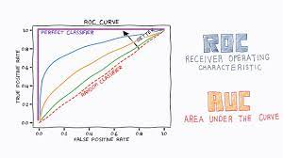
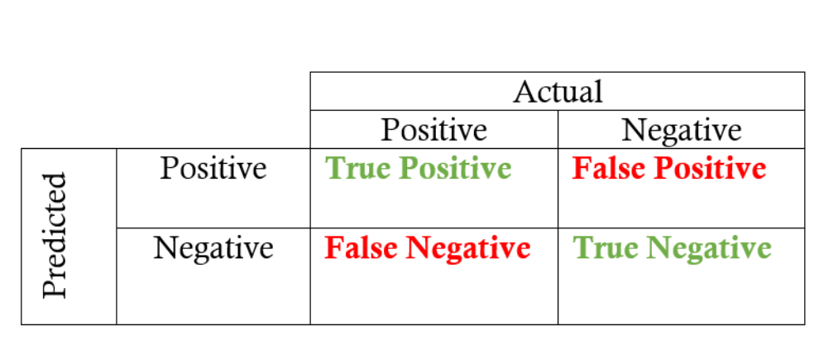
Scoring Parameters used to pick the best model
Confusion Matrix
Accuracy
Sensitivity
Specificity
ROC Curve

Slide 14
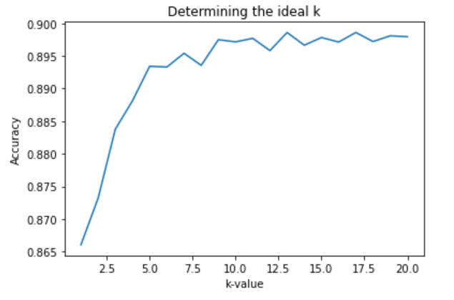
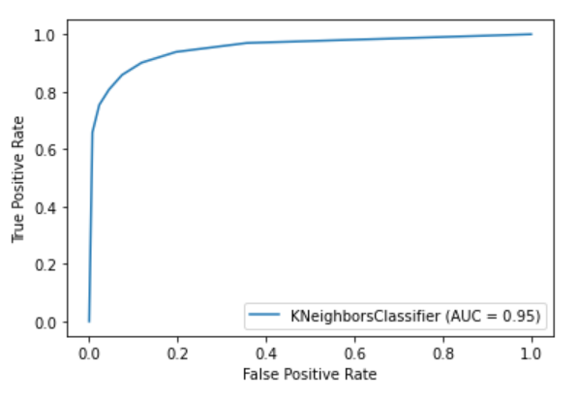
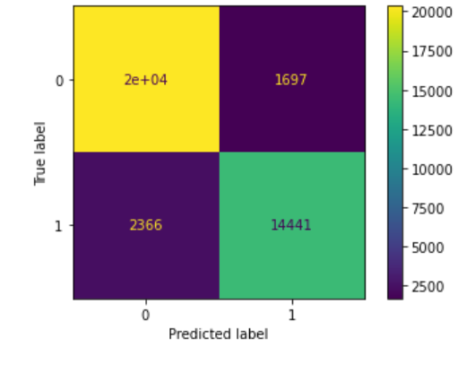
K Nearest Neighbours
Ran the algorithm for different values of k to determine the ideal value based on the best accuracy.
Got the confusion matrix to determine the accuracy, Sensitivity, Specificity.
The ROC curve has an AUC of 0.95 which is impressive for a KNN model, we trained the data with other classification models to find the model with the maximum AUC.
Accuracy:0.897
SN:0.92
SP:0.86

Slide 15
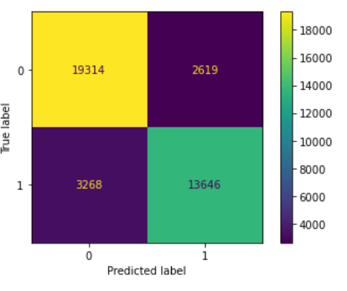
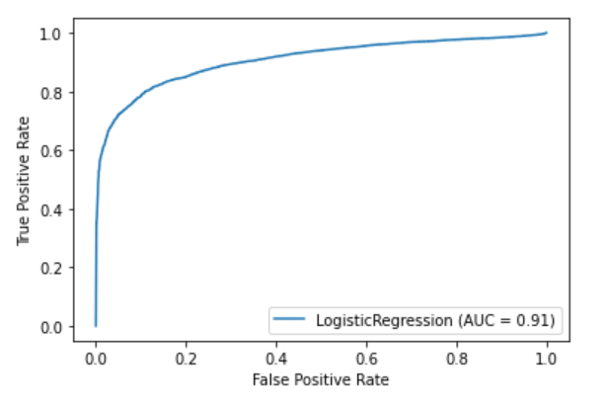
Logistic Regression
We implemented a different feature selection method for this model, instead of using the correlation factors, we used the chi-squared test and got the 10 best features that can be used for prediction of the outcome variable
From the ROC curve it can be seen that the AUC is significantly lower than knn, and even the accuracy is pretty low, this could be because of different feature selection method
Accuracy:0.85
SN:0.88
SP:0.81

Slide 16
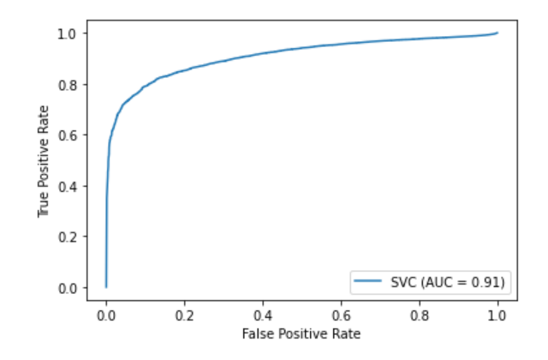
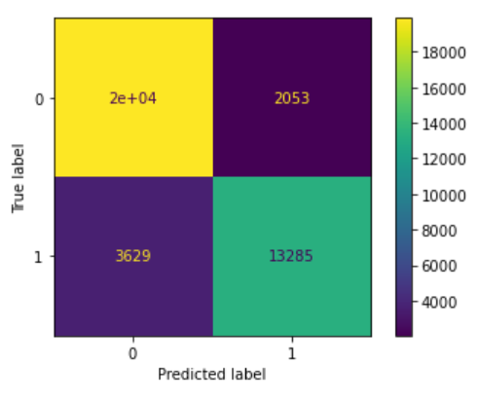
Support Vector Classifier
The dataset used for this classification method was the same as that used for Knn.
The AUC and accuracy values were similar to that of logistic regression
This indicates that the data set is not easily separable using the decision planes that SVM uses; i.e. the basic SVM uses linear hyperplanes to separate classes
Accuracy:0.85
SN:0.88
SP:0.78

Slide 17
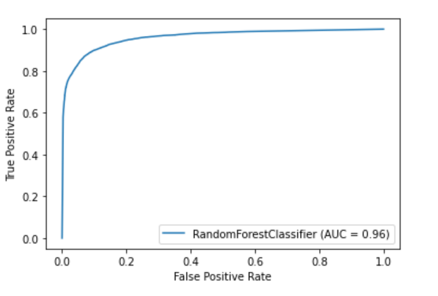
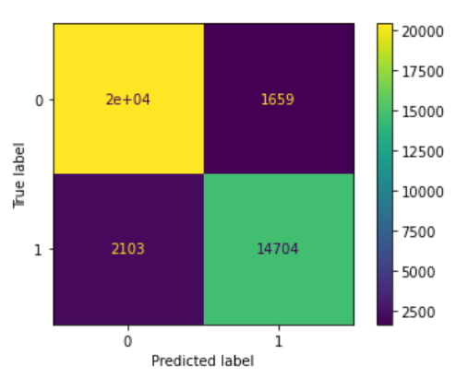
Random Forest Classifier
Chose the dataset after determining the correlation based on the cutoff values
Determined the confusion matrix and concluded that it had the best accuracy
From the ROC curve, the AUC value for this model was 0.96, which was the highest among all the models that we implemented.
Accuracy:0.903
SN:0.88
SP:0.97

Slide 18
THANK YOU!!

